Slide 1
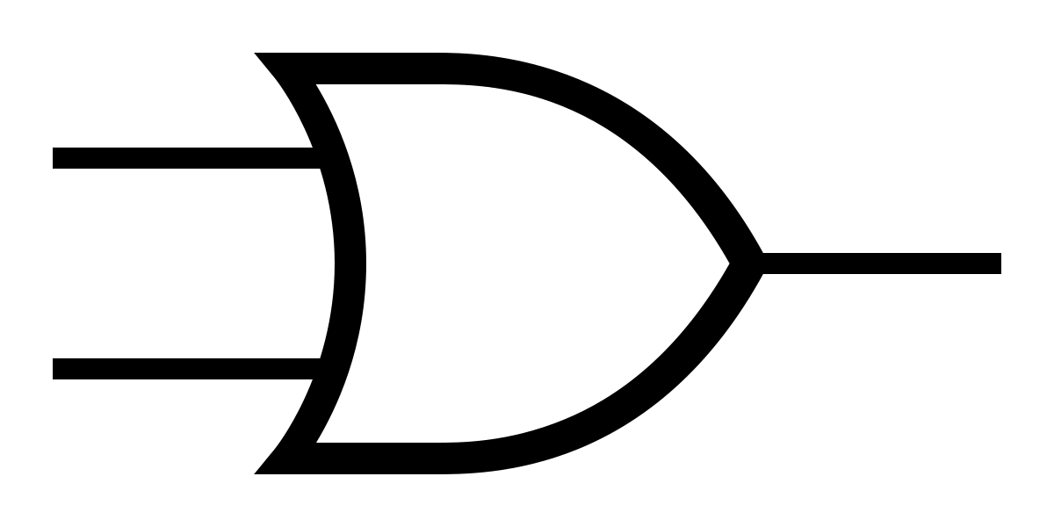


FEA Solutions

Slide 2
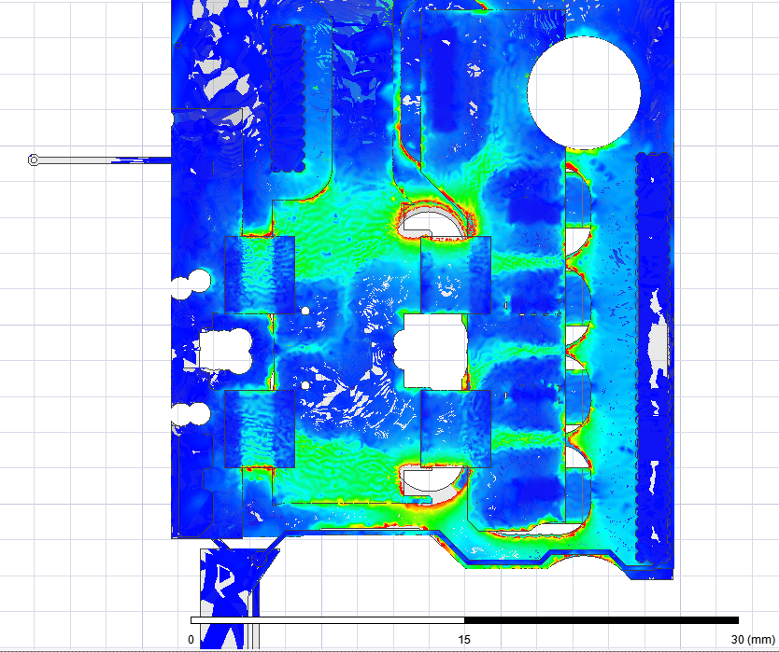
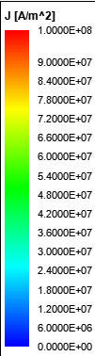
FEA Solutions
Comsol
Simplified PCB model is must
Manual meshing
Maxwell 3D
Complex PCB model is fine as long as we are okay with waiting
Automatic meshing is fine

Slide 3
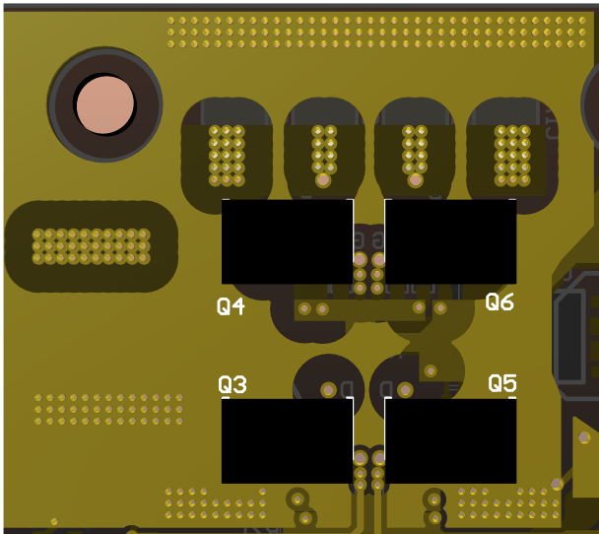
FEA Solutions

Slide 4
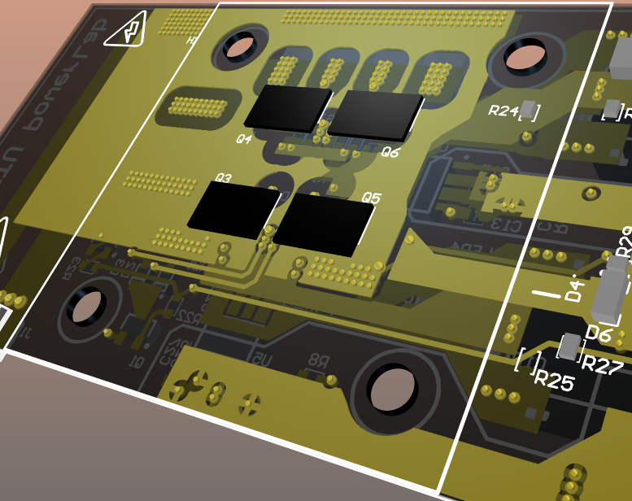
FEA Solutions
Minimum Inductance Paths

Slide 5


FEA Solutions
 | Frequency | Inductance | Resistance
Maxwell 3D | 200 MHz | 74.7 nH | 130 mohm
Q3D | 200 MHz | 0.84 nH | 11 mohm
The power loop inductance cannot be 75 nH because DPT under 400V / 40A would result in over-voltage breakdown for sure
We have 6 capacitors
This output should be evaluated based on these facts
All capacitors are seperately excited and they are combined in single winding; therefore, all capacitors are connected in series.
Total flux linkage should be divided to total current not a single coil excitation.
6 turns, for actual inductance divide it by 36 (N²)
Total current excitation is 6 times of the current used by Maxwell
$$\frac{75}{36}∗\frac{1}{6}=0.347 nH$$
But is it correct?

Slide 6
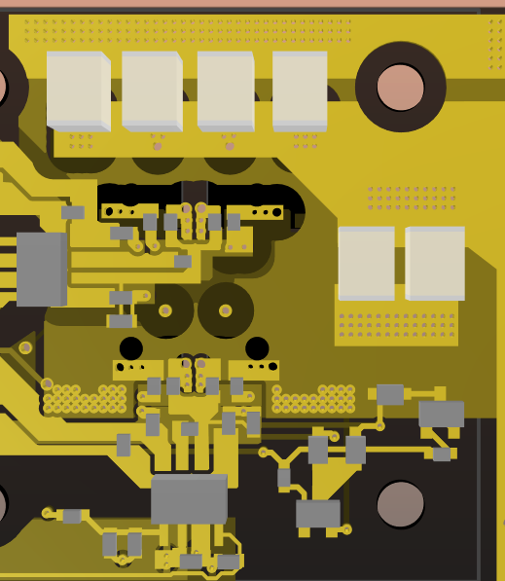
FEA Solutions
Each capacitor excitation are seperated into single windings which results in 0.5 nH – 1.8 nH self inductances for each capacitor. Equivalent inductance is the parallel combinations of those inductances: 0.19 nH
Winding #1
But mutual couplings?
0.01 nH < M < 0.5 nH
Winding #2
These two capacitor blocks can be considered as single
 | Winding #1 | Winding #2
Winding #1 | 1 nH | -0.21 nH
Winding #2 | -0.21 nH | 1.5 nH
If we consider these two source in parallel and ignore the mutual coupling, power loop layout inductance is equal to 0.6 nH @200MHz

Slide 7
This drop on reference level causes false signals

Slide 8
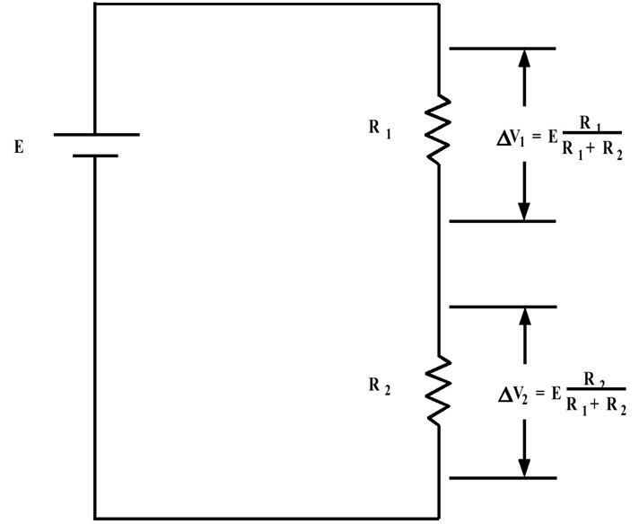
How to solve this problem?
Capacitive loading is important against sudden changes in circuitry. Two 1 uF ceramic capacitors connected in parallel with resistors

Slide 10
SCP mechanism is false triggered under this DPT conditions

